Slide 1
Week-07 Tasks
1

Slide 2
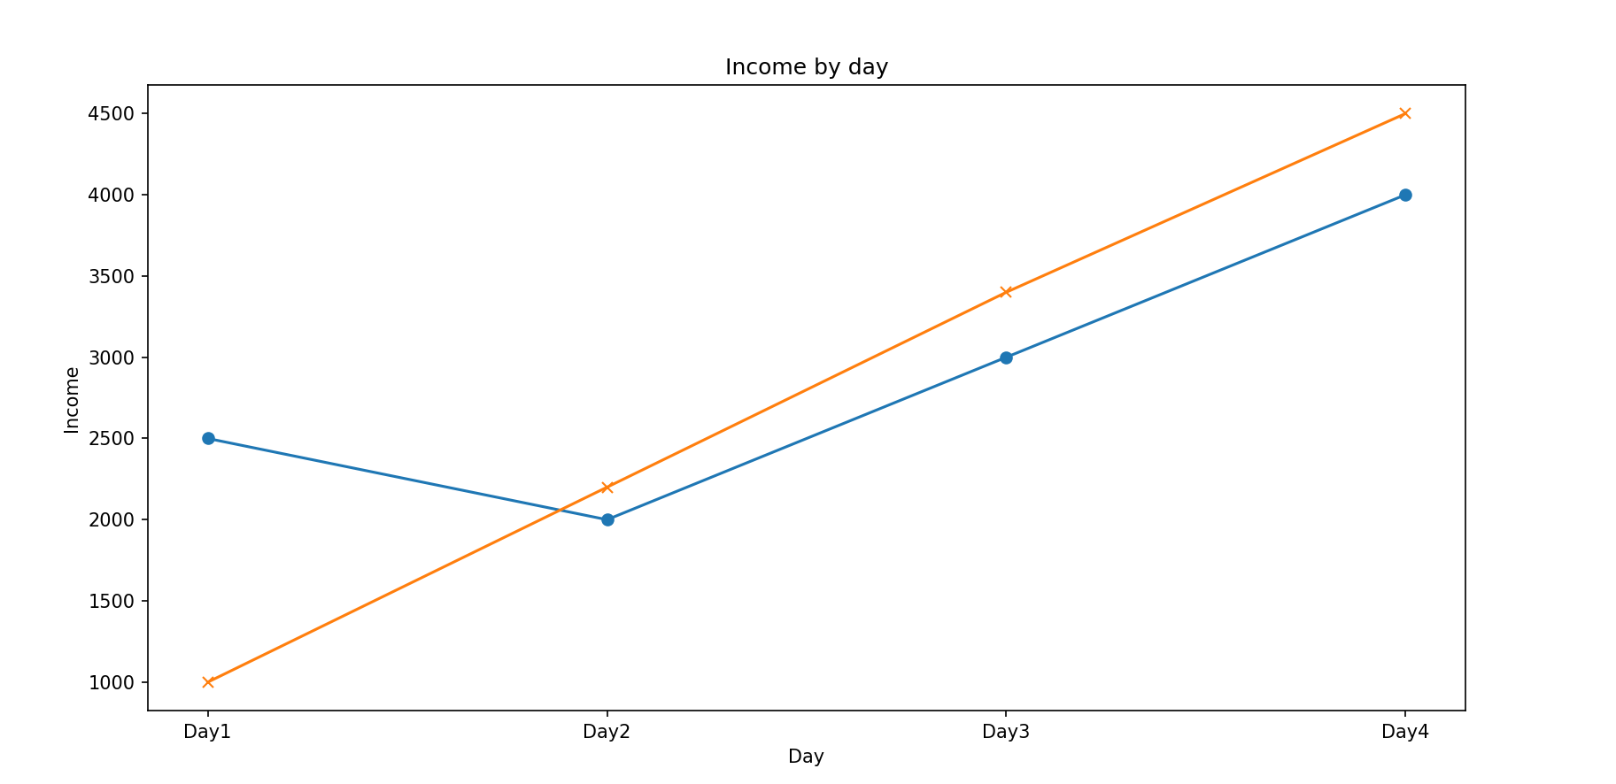
Task-01

Slide 3
Task-02
Create a bar with following data:
days = ['Day1','Day2','Day3','Day4','Day5','Day6','Day7','Day8','Day9','Day10'] sales = [2000,1000,500,100,5000,20000,1000,1500,2500,3500]
Output
Brand: Honda
Year: 2025

Slide 4
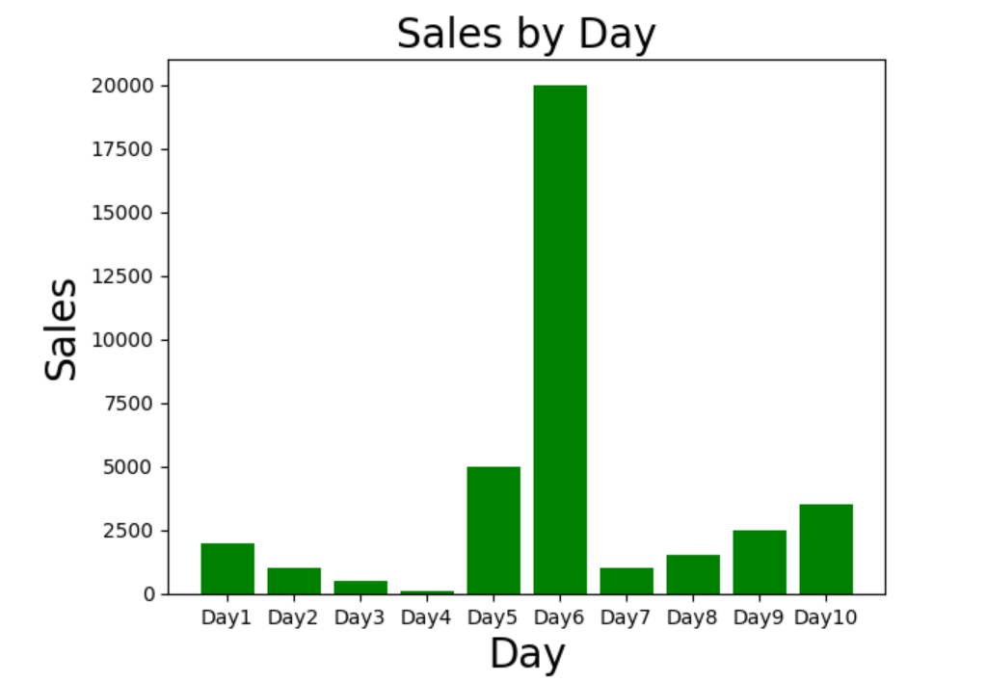
Task-02 Sample Output

Slide 5
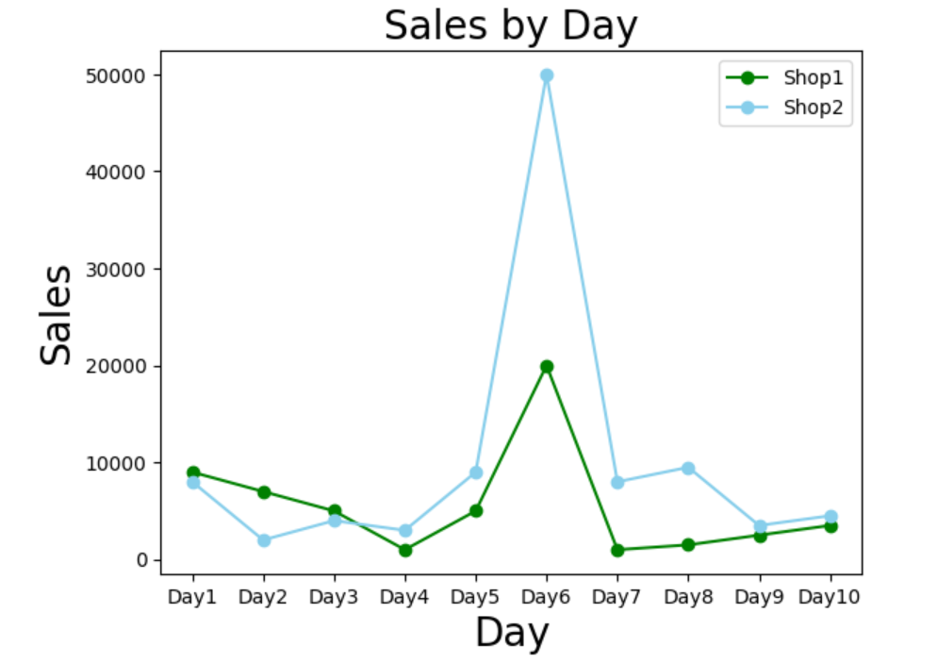
Task-03

Slide 6
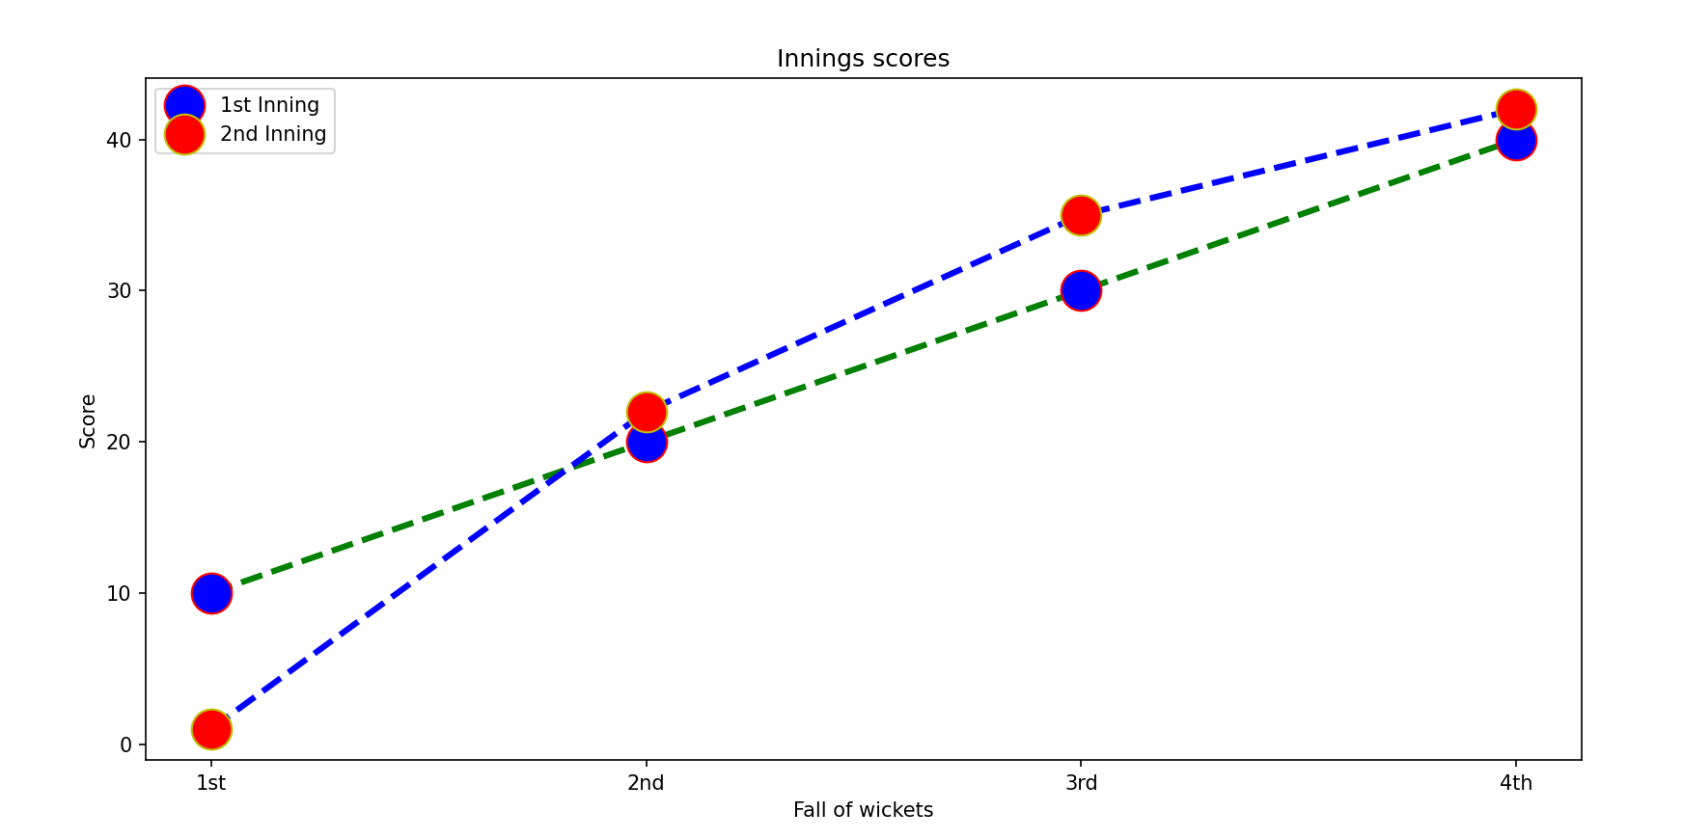
Task-04

Slide 7
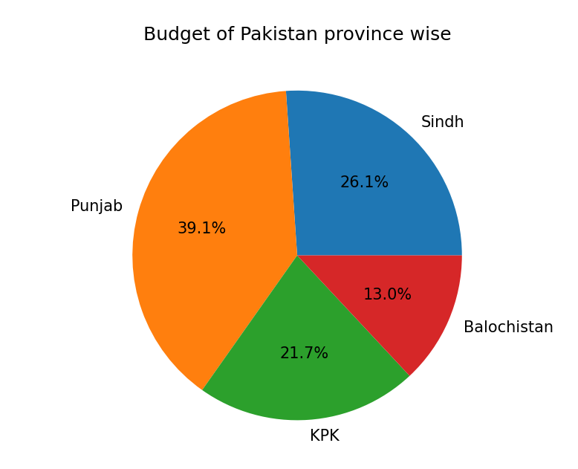
Task-05

Slide 8
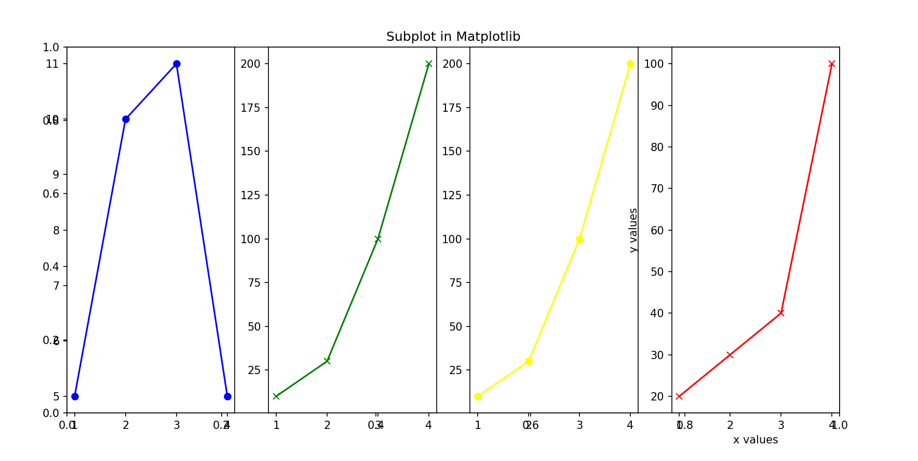
Task-06

Slide 9
Task-07
Create a dataframe that contains following data:
Name, Subject, Marks, Grade. There should be 10 entries. Perform following activities:
Display the result
Find the maximum marks
Count the number of A Grade
Group them by Grade

Slide 10
Task-08
Continue the task-07 and perform the following activities: a. Count the total null values
b. Fill the null values with the means of that column
c. Plot marks with student name using bar chart
d. Import this dataframe into CSV file

Slide 11
Task-09
Random Task
?

Slide 12
Task-10
Random Task
?

